Slide 1



Peer Learning Activity : Assessing learners’ competences: policies and practices to support successful and
inclusive education – Lisboa, May 24, 2023
Looking at Assessment for Learning through the Lenses of the PrACT Model
Lúcia Amante

Slide 2



Topics of this presentation
Contrasting the Culture of Testing with the Culture of Assessment
Characterising the assessment culture and its basic principles
Presenting the main dimensions and parameters of the PrACT framework for quality of pedagogical assessment design
Final remarks

Slide 3

Test culture
The literature on student assessment has shown over the years a variety of diverse conceptualisations and applications, but generally with the same meeting point: assessment as the measurement of learning objectives and comparison of learning outcomes, usually associated with knowledge acquisition, based on standardised tests or focused on grades, grade-oriented.
The psychometric assessment focuses on the extent of differences among students.
(Dierick & Dochy, 2001; Asting & Lising, 2012).

Slide 4

Assessment culture
Assessment moves away from the concern with measuring learning. It is seen as an integral part of the learning process and, like the learning process, it is a process of social interaction in which all participants should participate (Birenbaum, 2014; Pinto, 2016).

Slide 5


Test Culture
Assessment Culture
Psychometric perspective
Assessment of learning
Edumetric perspective
Assessment for learning
(Carver, 1974)
Notes:
The new assessment culture requires a new assessment concept.
The psychometric assessment focuses on the extent of differences among students. Is the test culture.
A avaliação edumétrica visa medir o desenvolvimento do próprio aprendente
The evaluation edumétrica aims to measure the development of learner itself. Considers: continuous assessment; Student centered learning; Explicit criteria; Process assessment; Competences assessment.
Furthermore, a paradigm shift is illustrated by Elwood and Klenowski (2002), when they distinguish “assessment of learning”, as assessment focused on measurement and scaling, from “assessment for learning”
New assessment culture supported by
edumetric criteria – assessment for learning
The new assessment culture requires a new assessment concept.
The psychometric assessment focuses on the extent of differences among students. Is the test culture.
A avaliação edumétrica visa medir o desenvolvimento do próprio aprendente
The evaluation edumétrica aims to measure the development of learner itself. Considers: continuous assessment; Student centered learning; Explicit criteria; Process assessment; Competences assessment.
Furthermore, a paradigm shift is illustrated by Elwood and Klenowski (2002), when they distinguish “assessment of learning”, as assessment focused on measurement and scaling, from “assessment for learning”
New assessment culture supported by
edumetric criteria – assessment for learning

Slide 6
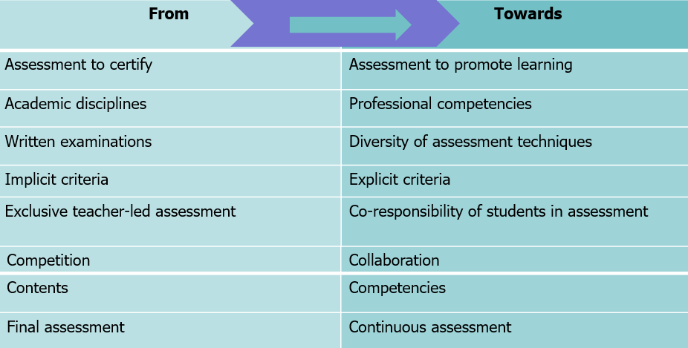
From the Test culture to the Assessment culture

Slide 7
PrACT Framework: Starting Point
Content-based curriculum
Competency-based curriculum
Face to face, Elearning, Hybrid contexts
Aulas presenciais
Content assessment
Assessment of competences

Slide 8
Assessment dimensions - PrACT model
Similitude
Complexity
Adequacy
Significance
Degree of similarity between the competences being assessed and those required in a real/professional context
Relates to the practicability of the digital assessment strategy
Cost
Efficiency
Sustainability
SOCIETY
INSTITUCION
Practicability
Authenticity
Consistency
Transparency
Validity and reliability requirements; Existence of a variety of assessment methods and contexts, evaluators and strategies
Instruction-evaluation alignment
Multiple indicators
Relevance of criteria
Alignment competence-evaluation
Transparency
Democratisation
Involvement
Visibility
Impact
Relates to visibility and to making the evaluation strategy understandable
TEACHER
STUDENT

Slide 9
Autenticity
It relates to the degree of similarity between the competences being assessed and those required in real/professional life in all their complexity and conditions of application.
Similarity
Competences required for real/professional life
Complexity
Cognitive challenge
Adequacy
Adequate conditions of realisation
Significance Value for students, teachers and employer

Slide 10
Consistency
It relates to the existence of a variety of assessment methods in different contexts, different assessors and the adequacy of the strategies used.
Alignment Instruction/ Assessment
Assessment tasks representative of lived learning situations
Multiplicity of indicators
Variety of assessment methods, contexts, times and assessors
Relevance criteria
The pertinence of criteria used
Alingnment competences/ assessment
Coherence between competences and assessment design

Slide 11
Transparency
This relates to visibility and making the assessment strategy understandable to students.
Democratisation
Participation in defining assessment criteria, objectives and assessors
Involvement
Participation in the definition of learning goals
Visibility
Sharing of processes and/or products
Impact
Effect on learning process and educational programme design

Slide 12
Practicability
Relates to the possibility of executing digital assessment strategy
Praticabilidade
Autenticidade
Consistência
Transparência
Cost
Time, resources or additional investments
Efficency
Considers the cost/benefit ratio of the assessment strategy design
Sustainability
Ensure the implementation and sustainability of the evaluation design
Grau de similitude entre as competências em avaliação e as requeridas em contexto real/profissional
Relaciona-se com a exequibilidade da estratégia de avaliação alternativa digital
Similitude
Complexidade
Adequação
Significância
Custo
Eficiência
Sustentabilidade
SOCIEDADE
INSTITUIÇÃO
Relaciona-se com a visibilidade e com o tornar compreensível a estratégia de avaliação
Democratização
Envolvimento
Visibilidade
Impacto
Existência de uma variedade de métodos e contextos de avaliação, de avaliadores e estratégias
ESTUDANTE
Alinhamento instrução-avaliação
Múltiplos indicadores
Relevância de critérios
Alinhamento avaliação-competências
PROFESSOR

Slide 13
Final remarks
The emergence of the assessment culture puts on the agenda the development of new criteria that allow to analyse the quality of the assessment strategies used, namely by using digital tools.
The PrACT model aims to contribute to the knowledge in the field of the development of quality assessment in different educational contexts, face-to-face, online or hybrid.
It intends to allow looking at the assessment in the light of the proposed parameters, assuming a new perspective in the design of the assessment process.
The criteria illustrate the different features of each dimension and provide na
operational description of the degree of achievement of each criterion.

Slide 14
References
Amante, L., Oliveira, I. & Gomes, M. J. (2019). E-Assessment in Portuguese Higher Education: Framework and Perceptions of Teachers and Students. In Ana Azevedo & José Azevedo (Eds.). Handbook of Research on E-Assessment in Higher Education (pp. 312-333). IGI Global. https://www.researchgate.net/publication/331197038_E-Assessment_in_Portuguese_Higher_Education_Framework_and_Perceptions_of_Teachers_and_Students
Astin, A. W., & Lising, A. (2012). Assessment for excellence: The philosophy and practice of assessment and evaluation in higher education. Lanham, Maryland: Rowman & Littlefield Publishers. Retrieved from https://goo.gl/Wl4UTk
Birenbaum, M. (2014). Conceptualizing assessment culture in school. In C. Wyatt-Smith, V. Klenowski & P. Colbert (Eds.). Designing assessment for quality learning. The enabling power of assessment Vol. 1 (pp. 285–302). Dordrecht: Springer.
Brinke, D. (2008) Assessment of prior learning. Maastricht, the Netherlands: Datawyse.
Carver, R. P. (1974). Two dimensions of tests: Psychometric and edumetric. American Psychologist, 29(7), 512–518
Dierick, S., & Dochy, F. J. R. C. (2001). New lines in edumetrics: new forms of assessment lead to new assessment criteria. Studies in Educational Evaluation, 27, 307–329.
Pereira, A., Oliveira, I., Tinoca, L., Pinto, M.C. & Amante, L. (2015). Desafios da avaliação digital no Ensino Superior. Lisboa, Portugal: Universidade Aberta. Disponível em https://repositorioaberto.uab.pt/handle/10400.2/5774
Pinto, J. (2016). A avaliação em educação: Da linearidade dos usos à complexidade das práticas“. In L.Amante & I.Oliveira (coords) Avaliação das Aprendizagens: Perspetivas , contextos e práticas. Lisboa: Le@D, Universidade Aberta (3-40). Disponível em: https://goo.gl/IWwZc8
Relaciona-se com a visibilidade e com o tornar compreensível a estratégia de avaliação
Existência de uma variedade de métodos e contextos de avaliação, de avaliadores e estratégias

Slide 15
Thank you! ☺
lucia.amante@uab.pt

